Slide 1
SMART PARKING
BY
MONIKA R

Slide 2
ABSTRACT
The rapid urbanization and escalating vehicular population in contemporary cities have exacerbated the perennial challenge of parking management. To address this issue, we propose an innovative IoT-based Smart Parking System designed to revolutionize urban mobility. This project leverages cutting-edge sensor technologies, real-time data processing, and user-friendly interfaces to provide a seamless parking experience for both drivers and parking operators.

Slide 3
SENSOR NETWORK DEPLOYMENT:
Utilizing a network of advanced sensors, including ultrasonic, infrared, and magnetic technologies, our system accurately detects the occupancy status of parking spaces in real-time
CENTRALIZED CLOUD-BASED PLATFORM:
The collected data is transmitted to a robust cloud-based platform for centralized processing and management. This platform is designed for scalability, ensuring uninterrupted service even in high-demand urban areas.

Slide 4
USER-FRIENDLY MOBILE APPLICATION:
A user-centric mobile application interfaces with the central platform, providing drivers with real-time information on available parking spaces, navigation assistance, and reservation options.
INTELLIGENT NAVIGATION AND RESERVATION:
The application employs intelligent algorithms to guide drivers to the nearest available parking spots, optimizing traffic flow and reducing congestion. Additionally, users have the option to reserve parking spaces in advance, ensuring a hassle-free experience.

Slide 5
SEAMLESS PAYMENT INTEGRATION:
The system integrates seamlessly with popular payment gateways, allowing users to make parking payments securely and conveniently through the application.
DATA ANALYTICS AND INSIGHTS:
The platform employs advanced data analytics to generate valuable insights into parking patterns, peak usage hours, and occupancy trends. This data empowers urban planners and parking authorities to make informed decisions regarding parking infrastructure and policies.

Slide 6
SMART ENFORCEMENT CAPABILITIES:
In-built alerts and notifications facilitate efficient parking enforcement, enabling authorities to address violations promptly.
ENERGY-EFFICIENT IOT DEVICES:
The deployed IoT devices are engineered with energy efficiency in mind, employing low-power modes to conserve resources while ensuring uninterrupted service.

Slide 7
ULTRASONIC SENSORS:
These sensors use ultrasonic waves to detect the presence of a vehicle in a parking space. They emit high-frequency sound waves and measure the time it takes for the waves to bounce back after hitting an object.
INFRARED SENSORS:
These sensors work by emitting and receiving infrared radiation. They can detect the presence of a vehicle based on the interruption of the infrared beam.

Slide 8
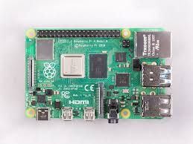
Raspberry Pi will collect data from sensors and update the mobile app.
Data from sensor
From the cloud server user get information
Cloud server

Slide 9
Select and Connect Sensors:
Choose the sensors you want to use (e.g., temperature, humidity, motion, etc.).
Connect these sensors to the GPIO (General Purpose Input/Output) pins on the Raspberry Pi.
Install Necessary Libraries:
Identify and install the appropriate libraries or drivers for your sensors. This could be done via the terminal using pip or by following specific installation instructions provided by the sensor manufacturer.
Write Sensor Reading Code:
Write a Python script to read data from the connected sensors. This script will interact with the sensor library or driver you installed in the previous step. It will collect the data and possibly perform any required processing.
Set Up Data Storage or Database:
Decide how you want to store the sensor data. This could be a file system, a database, or even a cloud service like AWS, Google Cloud, or a service like Firebase.
Implement Data Logging:
Modify your Python script to log the sensor data to the chosen storage location. Make sure you include appropriate error handling and data validation to ensure the integrity of the collected data.
Create an API (Application Programming Interface):
Develop an API on the Raspberry Pi. This API will serve as the bridge between the mobile app and the Raspberry Pi. Flask or Django (for Python) can be used to create a simple API.

Slide 10
Implement Data Transmission:
Within your API, create an endpoint that allows the mobile app to request sensor data. This could be done using HTTP requests (GET, POST, etc.).
Set Up Mobile App:
In your mobile app, you'll need to implement functionality to communicate with the Raspberry Pi. This will involve sending HTTP requests to the API endpoints you created.
Parse and Use Data in Mobile App:
Once the mobile app receives data from the Raspberry Pi, parse it and use it as needed. This could involve displaying it to the user or performing some processing on the data.
Implement Real-Time Updates (Optional):
If you want real-time updates, you might consider using technologies like WebSockets. This would allow the Raspberry Pi to push data to the mobile app as soon as it's available.
Handle Security Considerations:
Ensure that any sensitive data is transmitted securely (e.g., using HTTPS) and implement authentication mechanisms if needed.
Testing and Debugging:
Thoroughly test your system to make sure it works as expected. Debug any issues that arise.
Deployment:
Once everything is working correctly, you can deploy the system in your desired environment.

Slide 11
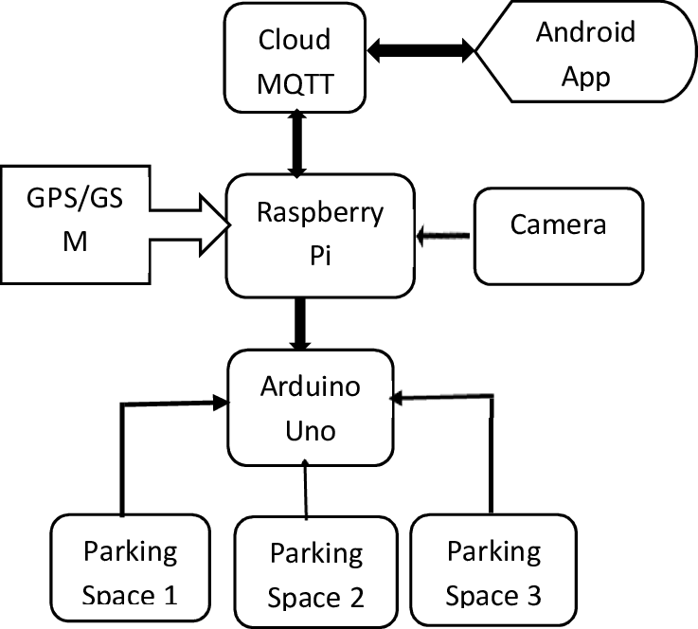
BLOCK DIAGRAM

Slide 12
BENEFITS:
REDUCED TRAFFIC CONGESTION:
By providing real-time parking availability information, our system minimizes the time spent circling for parking, leading to reduced traffic congestion and lower emissions.
OPTIMIZED SPACE UTILIZATION:
The system maximizes the utilization of parking spaces, resulting in increased revenue for parking operators and a more efficient use of urban infrastructure.
ENHANCED USER EXPERIENCE:
Drivers benefit from a streamlined parking experience, with convenient navigation, reservation options, and seamless payment processes.
DATA-DRIVEN URBAN PLANNING:
The collected data offers valuable insights for urban planners, enabling them to make informed decision

